Slide 1
Restaurant Management System

Slide 2
Presented By-
Maruf Ahmed Rahad
Id: 16172103253
Md.Yeasin Arafat
Id: 16172103249
Supervised By-
Suman Saha
Assistant Professor
Department of Computer Science and Engineering (CSE)
Bangladesh University of Business and Technology (BUBT)
Mirpur, Dhaka.

Slide 3
Contents
Introduction
Motivation
H/W and S/W Requirements
Proposed Model
Snapshots of the Project
Limitations & Future Plans
Conclusion

Slide 4
Introduction
Amount of every item
Making bill calculation
Item tracking
Item rate calculation
Make each item bill and total bill
Export bill as PDF
Judge item
Total selling amount date to date
Special member registration

Slide 5
Motivations
The objectives of the project are follows:
To make a system that reduce the time to maintain a restaurant.
To keep track of members records.
To calculate item rate correctly.
To keep special members biodata in electronic media.
To keep track of total sales

Slide 6
H/W and S/W Requirements
Hardware Requirement Specifications:
RAM: 1 GB
Processor: Intel Family
Software Requirement Specifications:
Xampp
Visual Studio

Slide 7
Proposed System
Security of data
Ensure data accuracy
Minimize manual data entry
Greater efficiency
Better service
User friendly and interactive

Slide 8
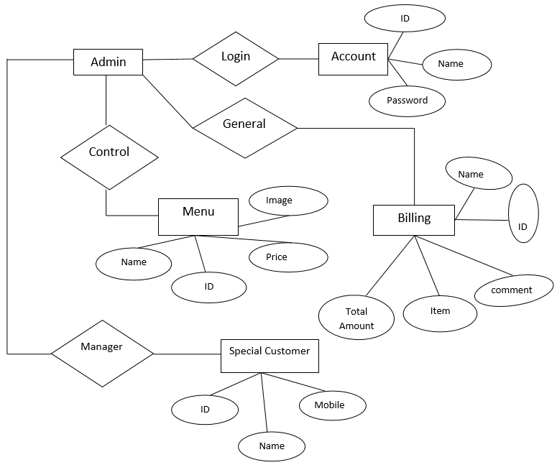
System design
Use Case
Diagram:
Figure: Use Case Diagram

Slide 9
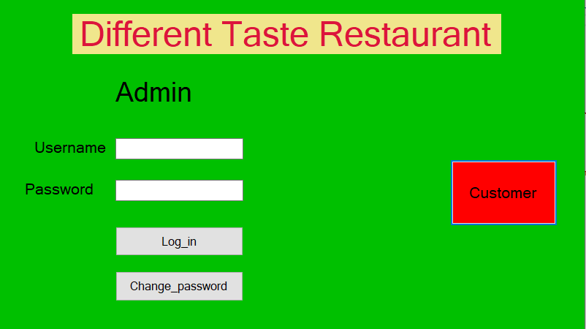
Snapshots
Welcome and Login:
Figure: Login

Slide 10
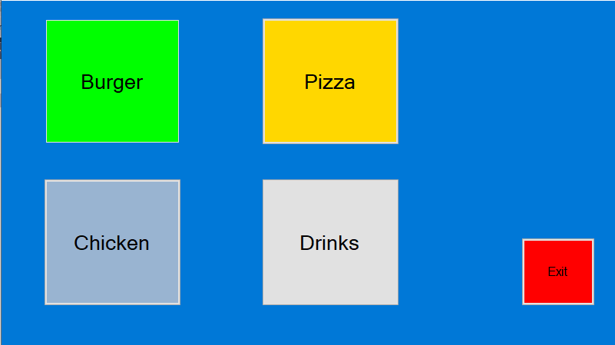
Continue…..
Item Category Selection Page:
Figure: Item Category

Slide 11
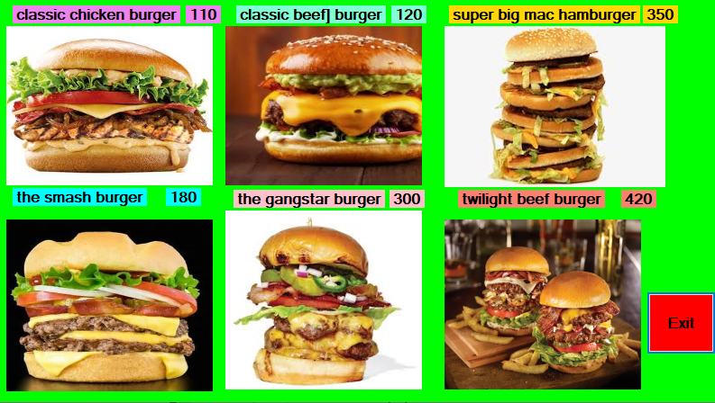
Continue…..
Burger:
Figure: Burger Item

Slide 12
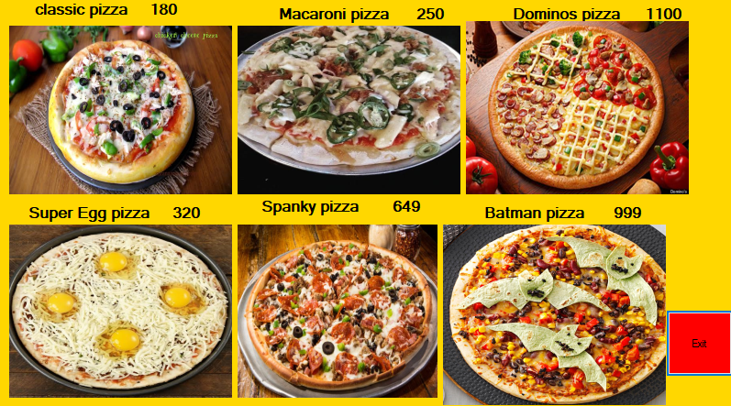
Continue…..
Pizza:
Figure: Pizza Item

Slide 13
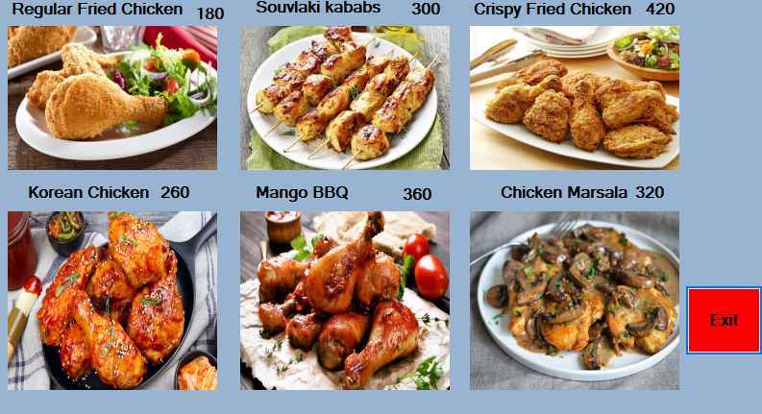
Continue…..
Chicken:
Figure: Chicken Item

Slide 14
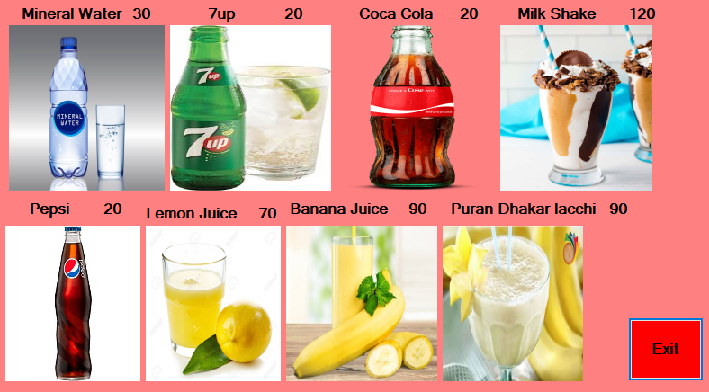
Continue…..
Drinks:
Figure: Drinks Item

Slide 15
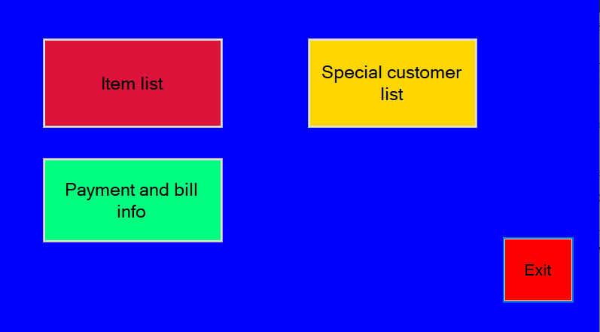
Continue…..
Manager’s Page:
Figure: Manager’s Page

Slide 16
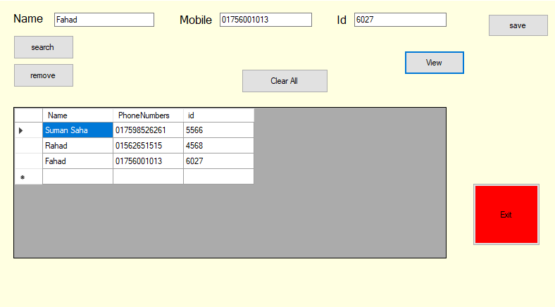
Continue…..
Special customer’s Page :
Figure: Special customer’s page

Slide 17
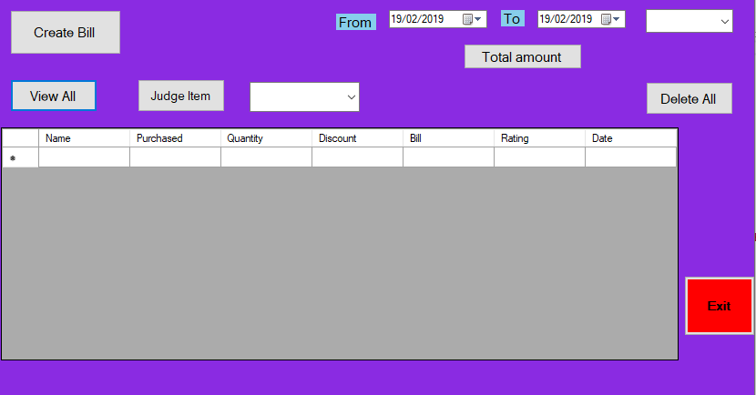
Continue…..
Bill and judge Page :
Figure: Bill and judge Page

Slide 18
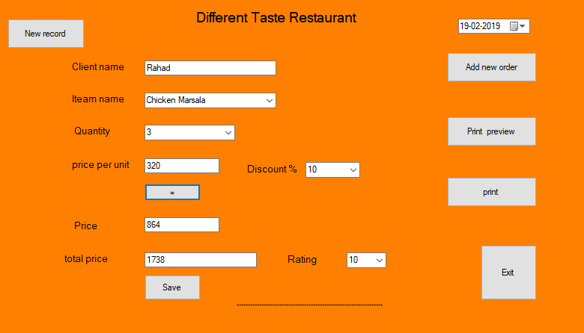
Continue…..
Making Bill page :
Figure: Making Bill page

Slide 19
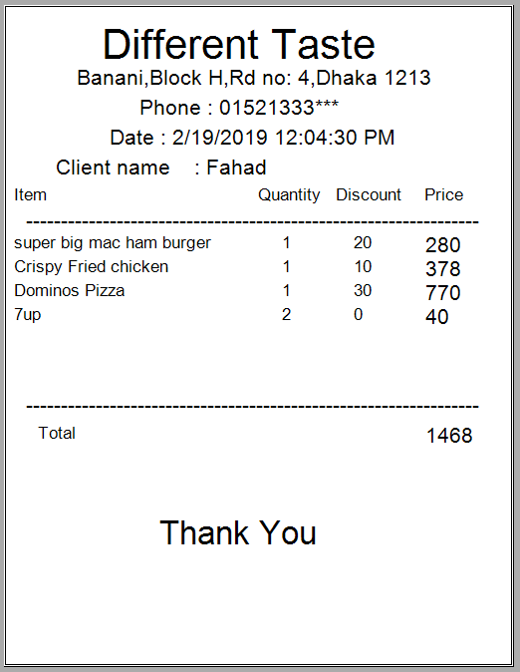
Continue…..
Bill showing pdf format :
Figure: Bill showing pdf format

Slide 20
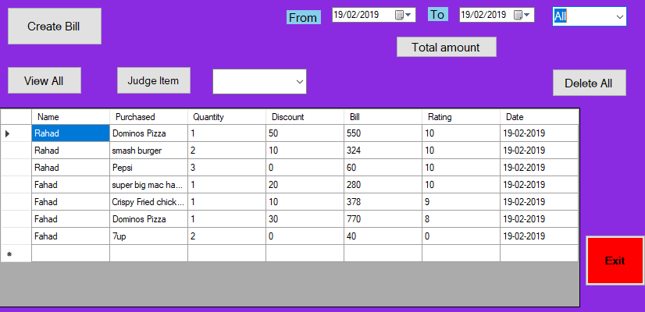
Continue…..
Judging page :
Figure:Judging page

Slide 21
Limitations
Need to install first on computer before using.
Platform is not independent. So, it may not run on different operating systems like MacOS, Ubuntu, Linux.
Some minor bugs exist
Limited features, need to explore.

Slide 22
Future Plan
Advance records filter options.
Records export in different formats like csv.
Improve the exported reports

Slide 23
Conclusion

Slide 24


